Slide 1



Fit Santa
John Steskal
Billy Lau
Chris Obonaga

Slide 2
Motivation & Summary
Hypothesis:
If we review search interest correlation during Christmas, then we can best ensure marketing campaigns are property applied.
Questions:
Is there a positive correlation between search terms and dating sites?
A: if there is a positive correlation, then advertisers can have a better marketing strategy.
When is the best and worst time to put a marketing campaign during Christmas?
A: if there is a negative correlation - that would be the worst time, whereas a positive correlation would indicate the best time .
Which is the worst dating site to advertise for search phrases?
A: if there is a negative correlation between the search phrase and dating site, then that would be the worst site to advertise.
What kinds of data is needed:
Google Trends (Open API)

Slide 3
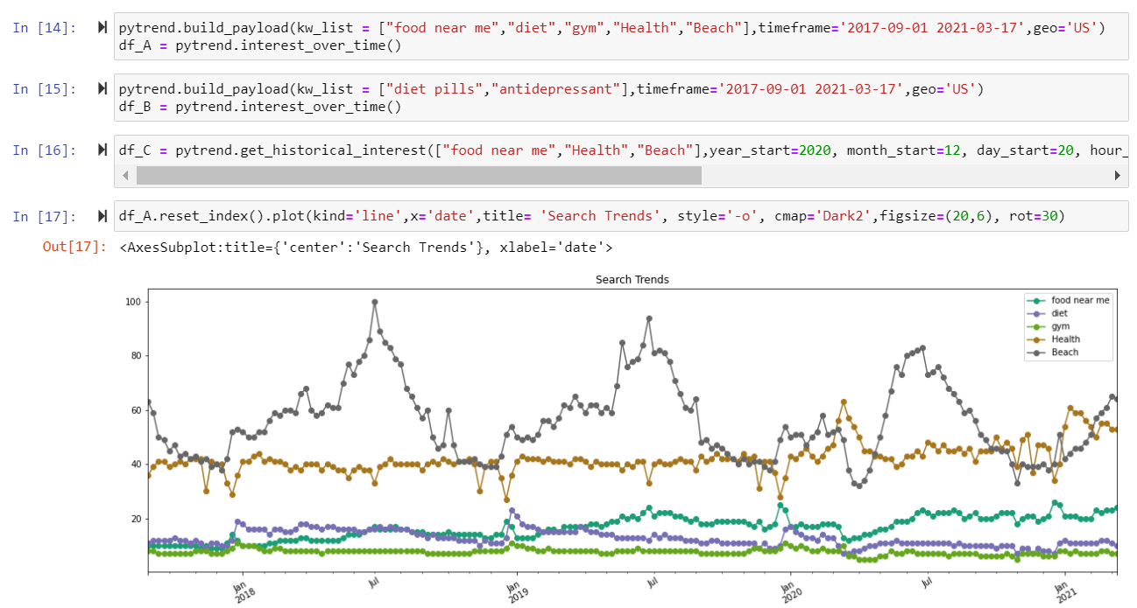
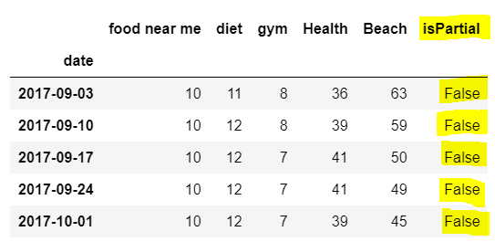
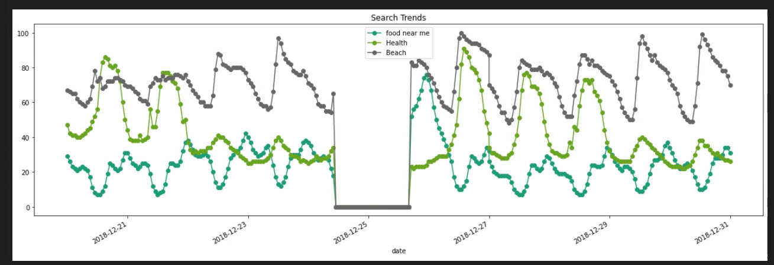
Data Cleanup & Exploration
Exploration :
Cleanup process:
Too much data
Dropped “isPartial column”
Data gaps in data from Google (hourly)
Bins by days

Slide 4
Data Analysis
Steps taken to analyze data:
Retrieved Google trend data
Sanitized the data
Created DF based on search
Correlation between searches
Created DF for dating apps and correlation to search DF
Bin by date
Correlation plot based on pre and post Christmas
Plot and graphs

Slide 5
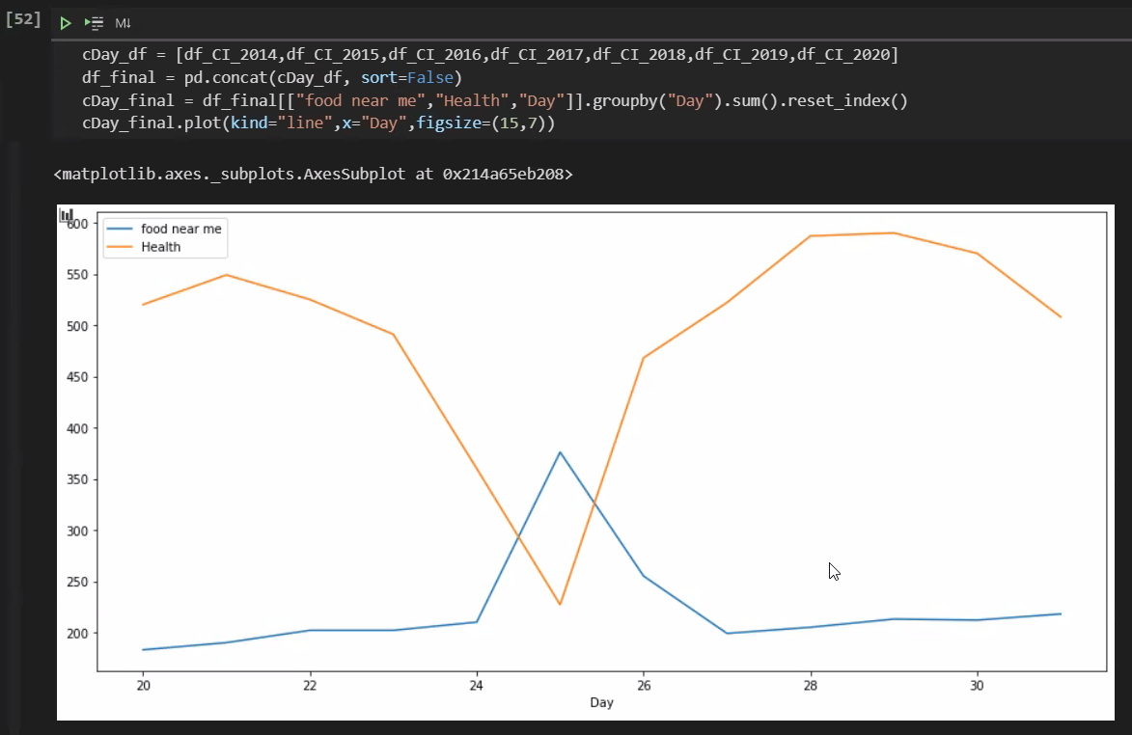
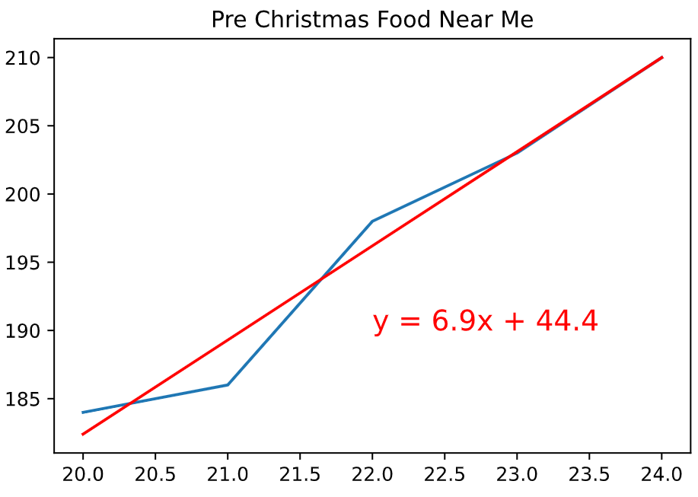
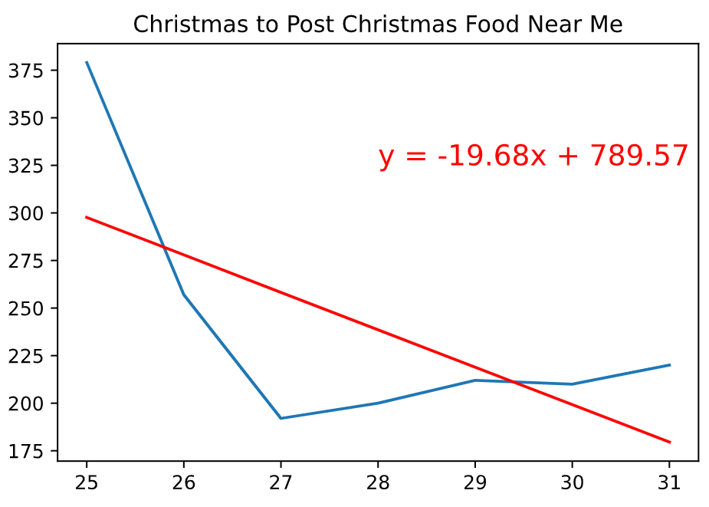
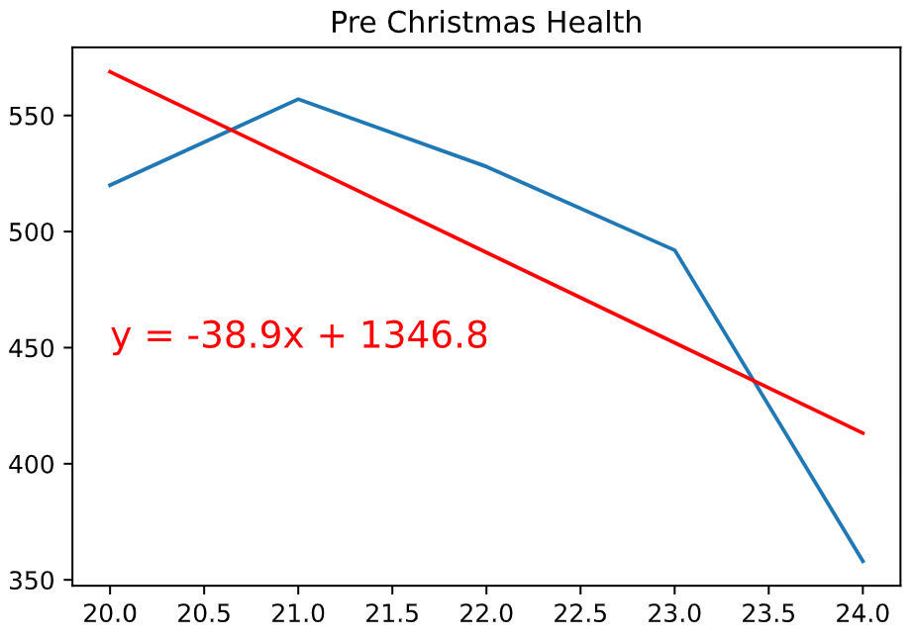
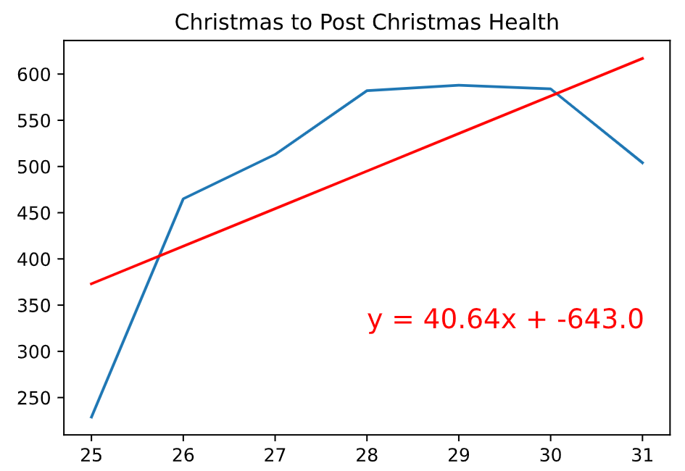
Data Analysis
Initial graph for Health and Food Near Me
Pre-Christmas
Christmas +

Slide 6
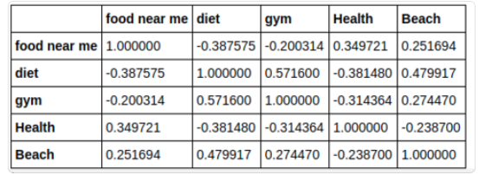
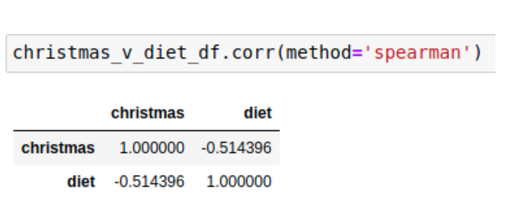
Data Analysis
Interesting figures developed :
Positive and negative correlation to search terms
“diet” queries have neg correlation to “food near me,” but pos correlation to “gym.”
Christmas and Diet has a negative correlation
Santa is still fat in Christmas

Slide 7
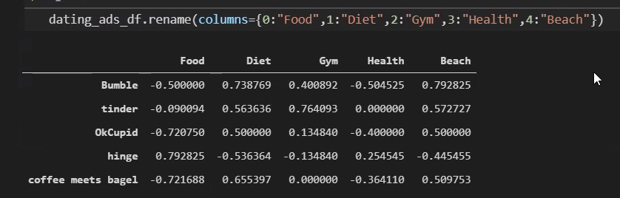
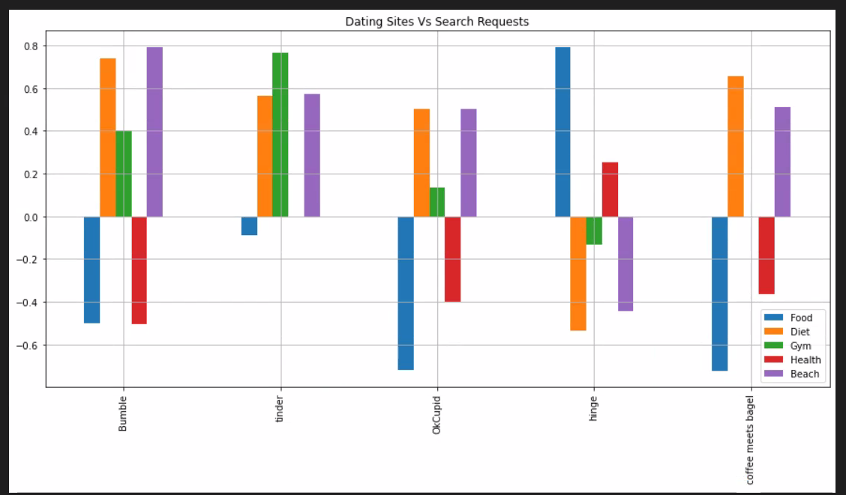
Data Analysis
Interesting figures developed :
Pos & neg correlation for search terms and dating apps

Slide 8
Discussion
Did you find what you expected to find? :
Yes – and then some!
Christmas correlation as Pre-Christmas and Post-Christmas.
When and when not to advertise

Slide 9
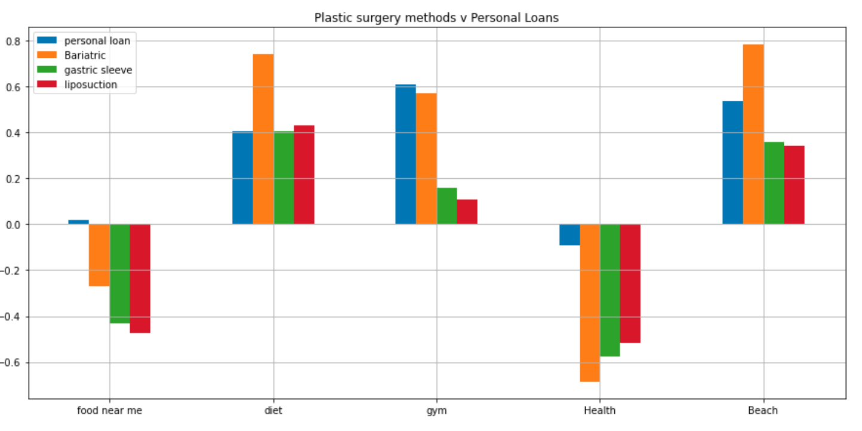
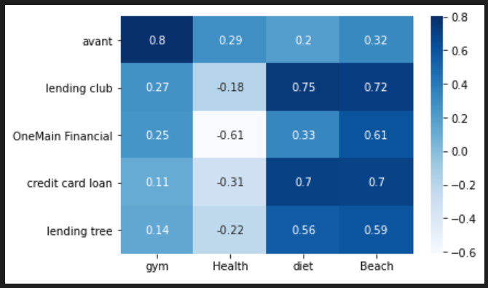
Postmortem
Difficulties that arose:
Too much data
Missing data (25th)
Correlating data but missing meaning… (regression before and after Christmas)
Additional questions that came up:
What happens when users don’t achieve their goals?
surgery and how would they finance it

Slide 10

Questions?

